Slide 1
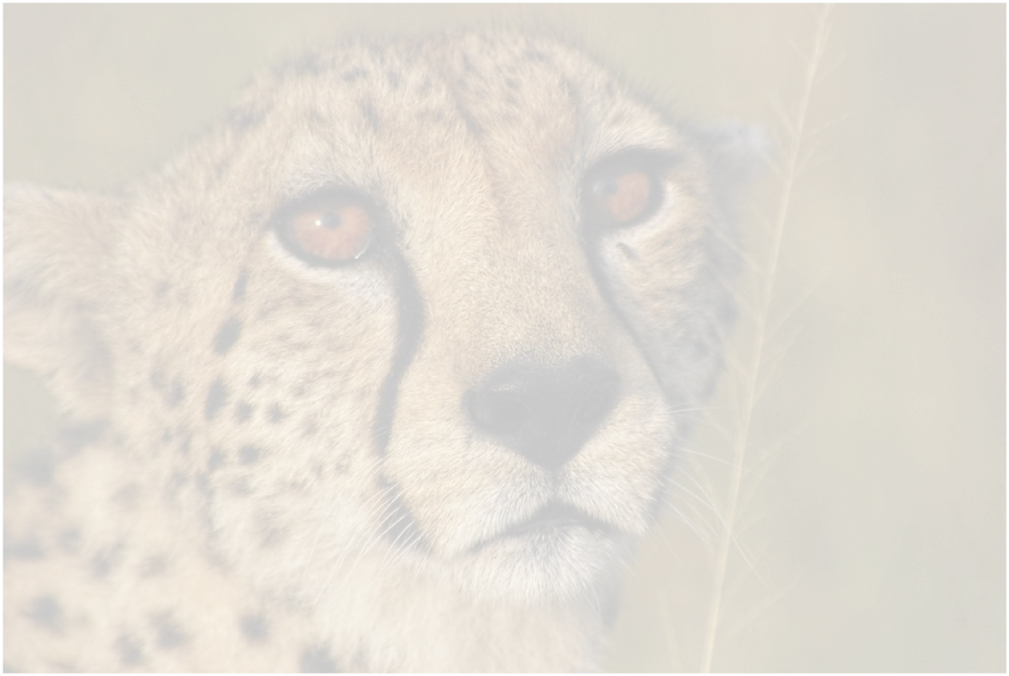
Cheetahs
By Ziya

Slide 2
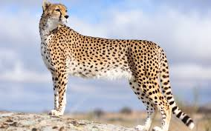
BAsic facts
The cheetah is the fastest land animal in the world and can run up to 100km per hour.

Slide 3
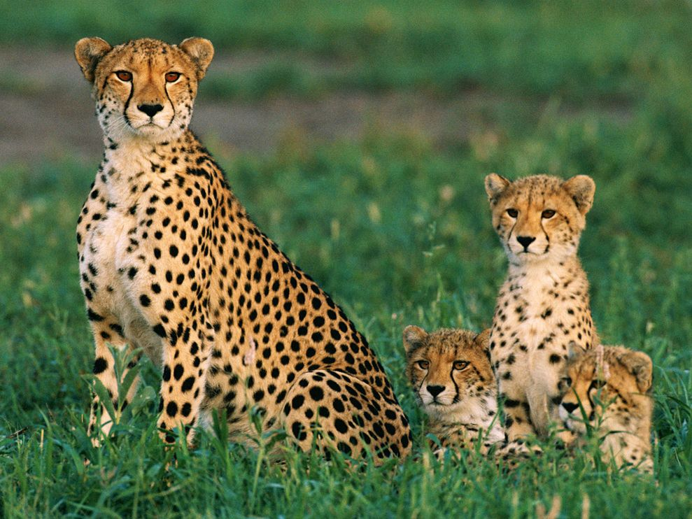
What do they look like?
Cheetahs are tan in colour and have black spots all over their bodies.They also have stripes that stretch from the corner of their eyes to the side of their nose.

Slide 4
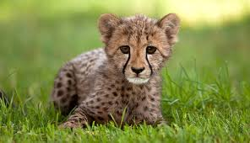
Where do they live?
Historically cheetahs were found throughout Africa and Asia.They are now confined to parts of Africa and a small portion of Iran.

Slide 5
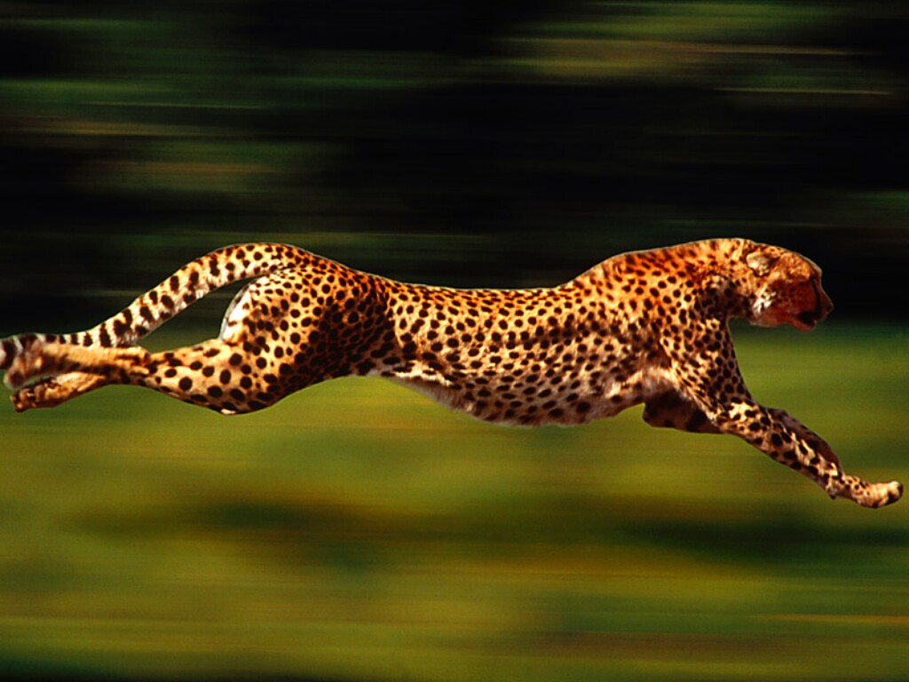
Hunting
Found mostly in open savannah, cheetahs rely on tall grasses for camouflage when hunting.Only half of the chases, which last from 20-60 seconds are successful!

Slide 6
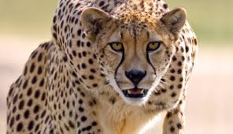
Their diet
Cheetahs mainly eat gazelles, wildebeest calves, impalas and other smaller hoofed animals.

Slide 7
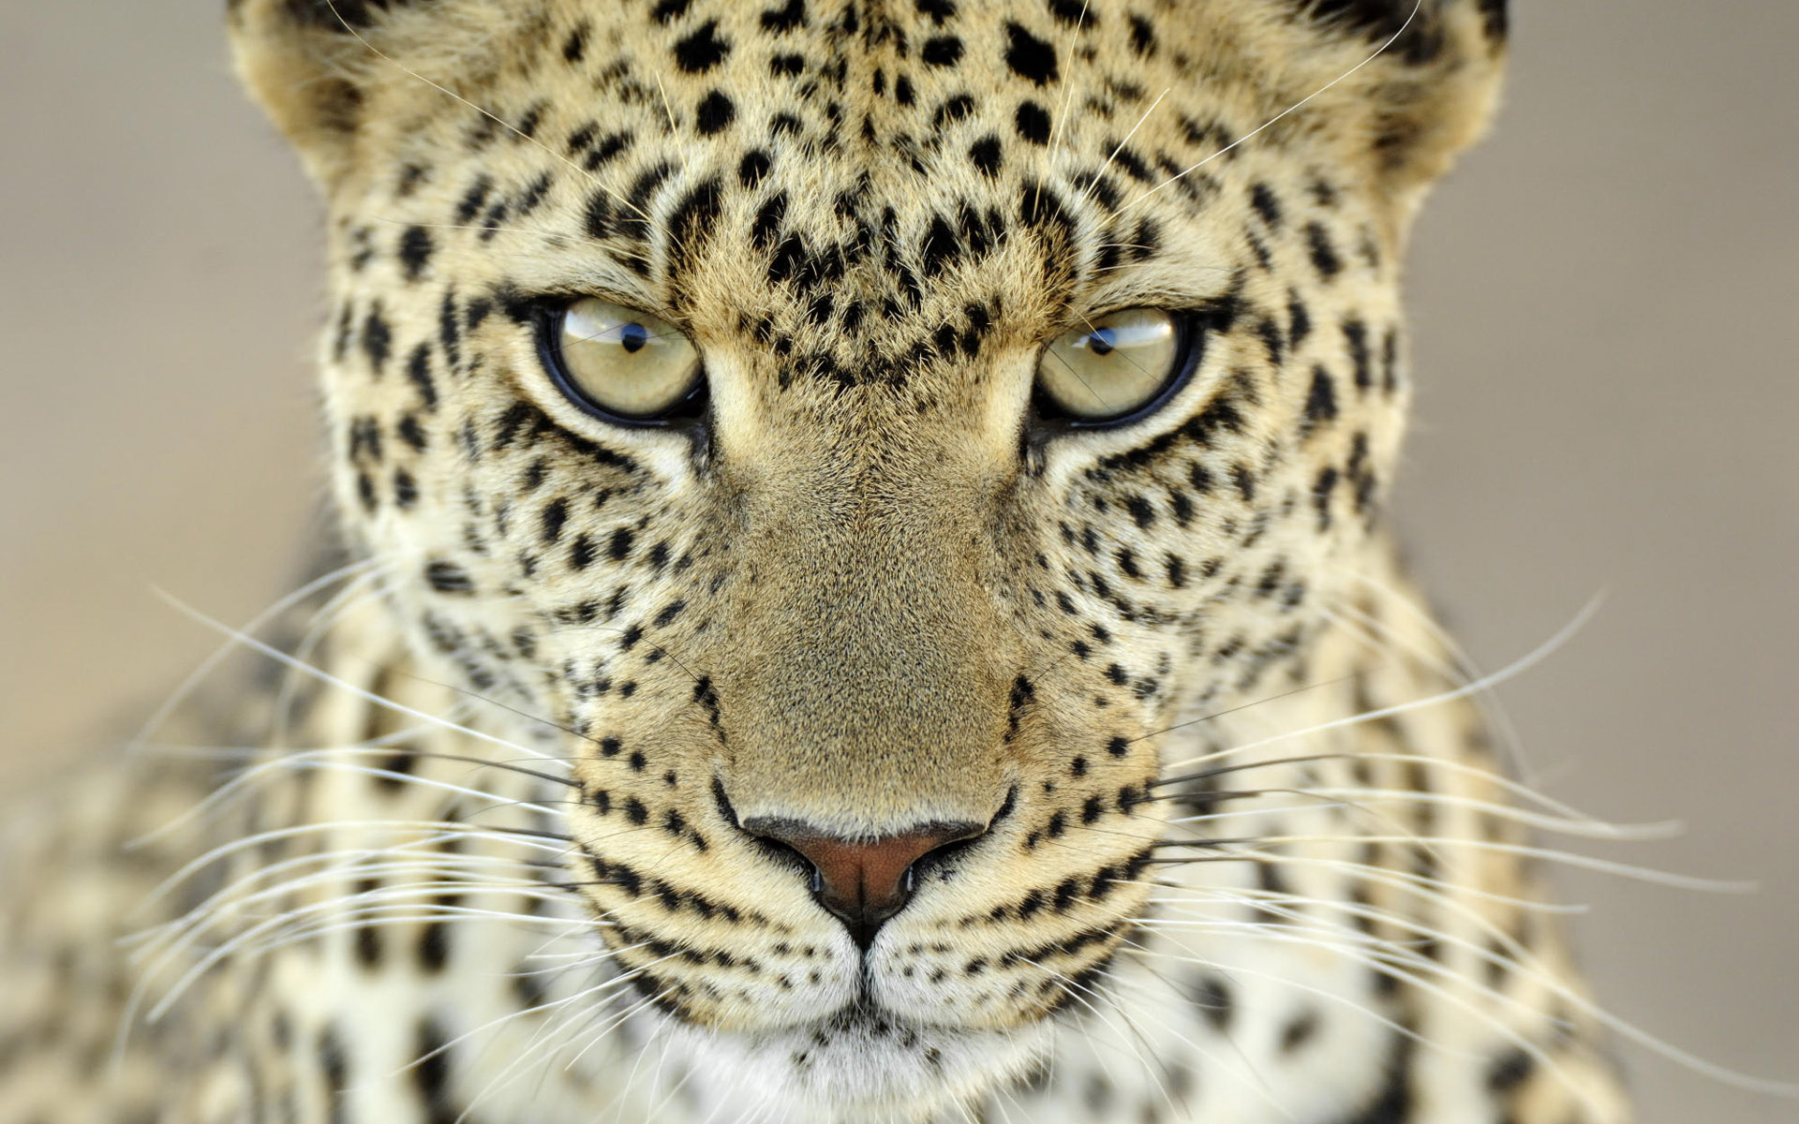
By ziya aragorn akkoç
P.S cheetahs are amazing animals and they shouldn't be endangered.

